Slide 1
What is InstaShop?
"InstaShop" is a user-friendly ecommerce website that provides a seamless shopping experience for customers. With a sleek and modern design, customers can easily browse and purchase products from a wide range of categories, including fashion, electronics, home goods, and more. The site features high-quality product images, detailed product descriptions, and a convenient shopping cart system, making it easy for customers to find what they're looking for and complete their purchase. In addition, InstaShop offers fast and reliable shipping, a secure checkout process, and friendly customer support, ensuring that customers have a positive shopping experience from start to finish.

Slide 2
Navbar
The "Navbar" of InstaShop's website is a key component of its user-friendly interface. The top of the website features the brand name in a prominent location, ensuring that customers are always aware of which site they are shopping on. Beside the brand name, there is a search box that makes it easy for customers to quickly find what they're looking for. The search box is intuitive and provides relevant results in real-time, helping customers to find the products they want more efficiently. The Navbar also features a shopping cart icon, which displays the number of items in the customer's cart and allows them to quickly access and review their cart at any time. Finally, there is a "Sign In" button that allows customers to log into their account or create a new account, giving them access to additional features such as order history and personalized recommendations. The Navbar of InstaShop's website is designed to be simple, intuitive, and user-friendly, making it easy for customers to navigate and find what they're looking for.

Slide 3
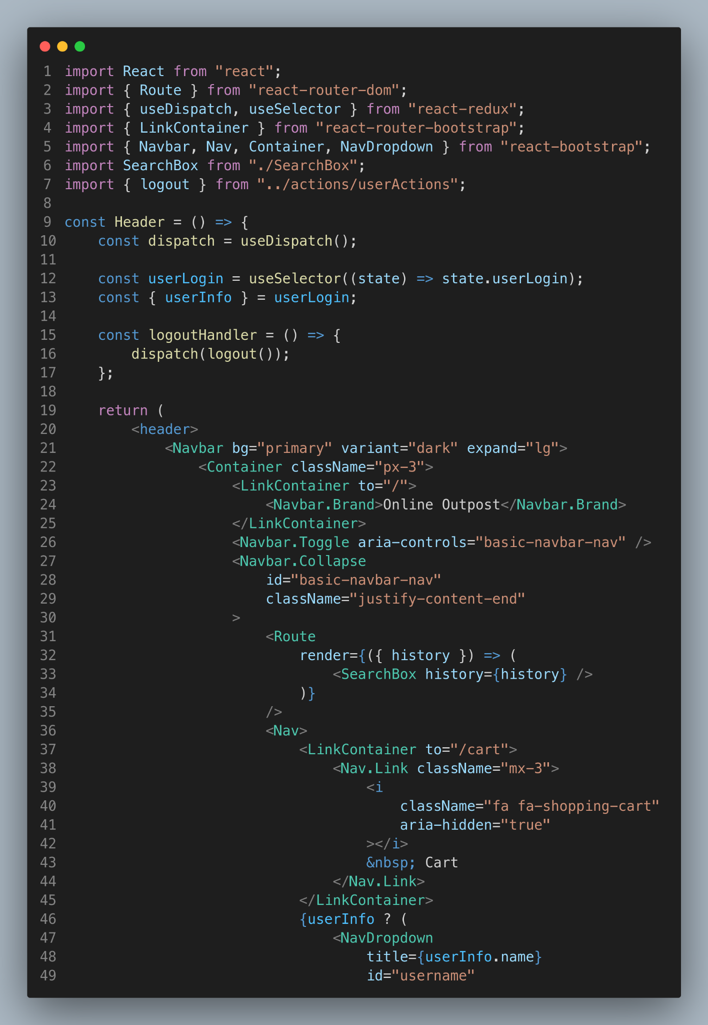
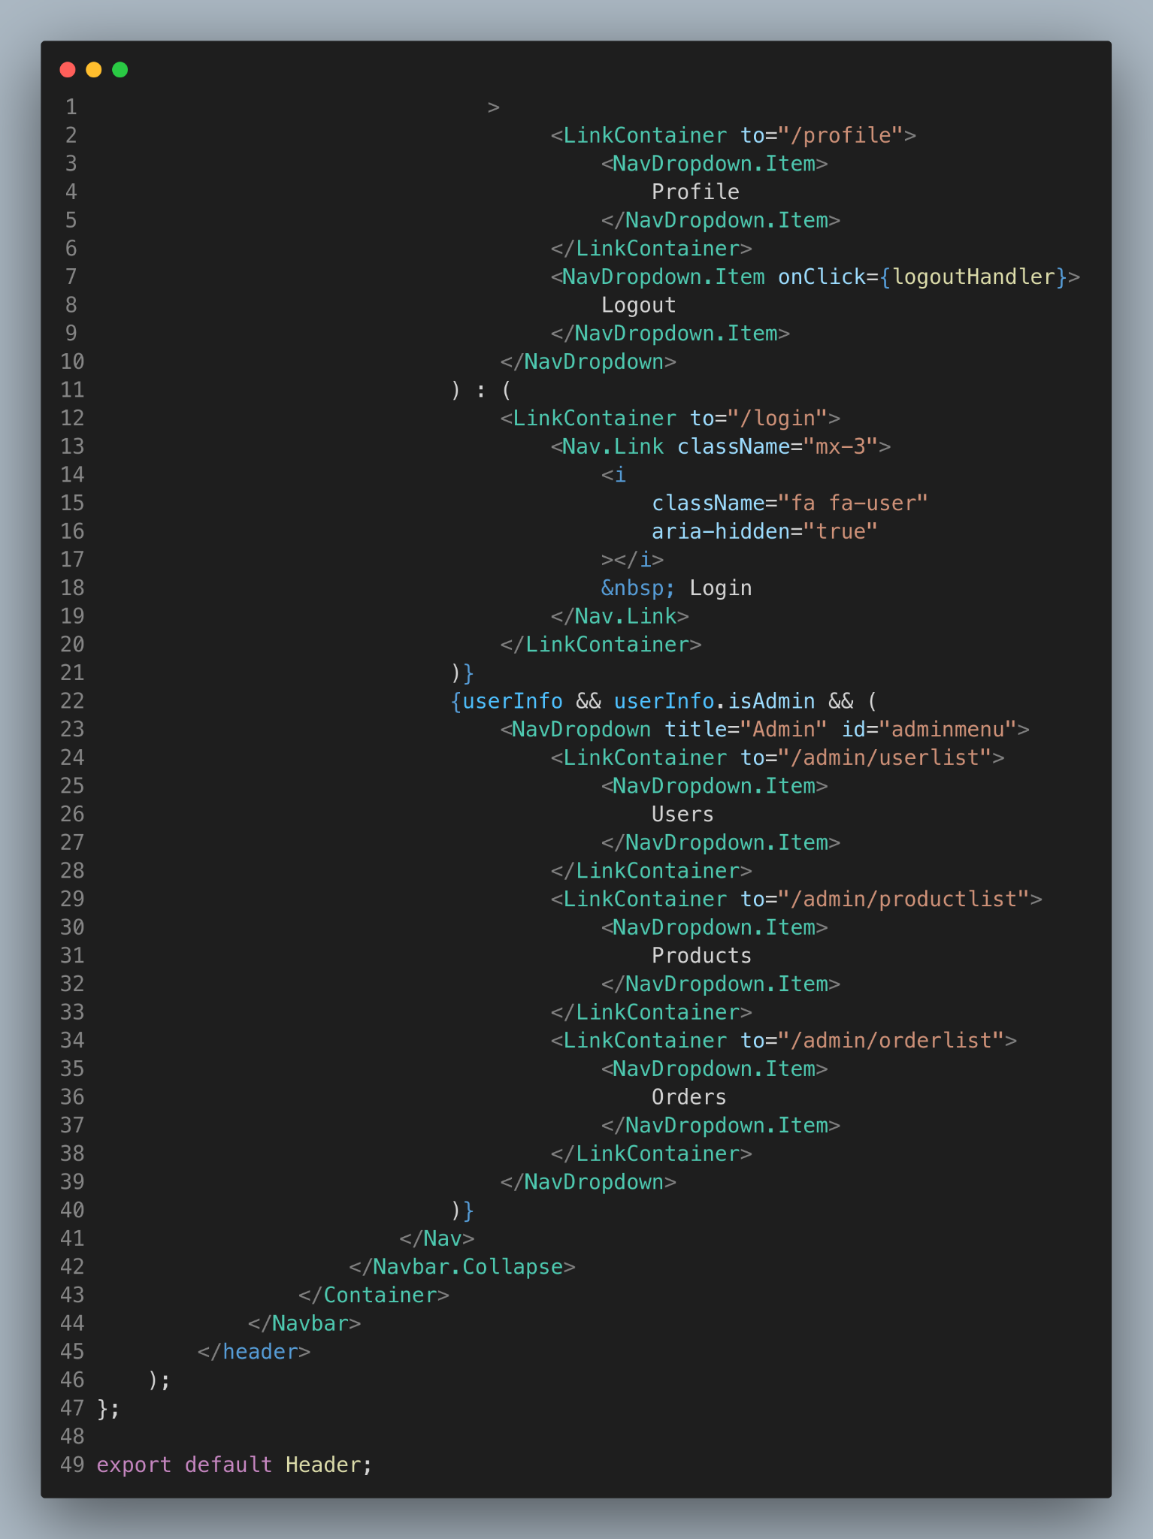

Slide 4
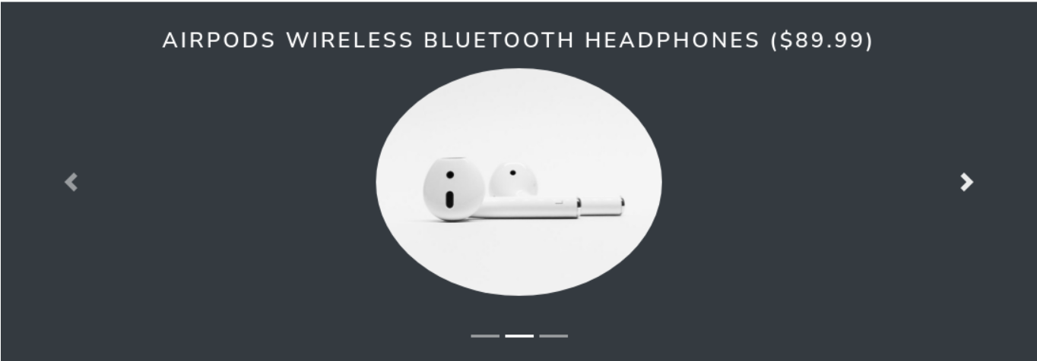
Product Carousel
The Product Carousel in InstaShop's ecommerce website displays the top products in a visually appealing slider format. As users scroll through the carousel, they can view high-quality images of the products and quickly access detailed information. This feature makes it easy for users to discover new products and find what they're looking for, all in one place.

Slide 5
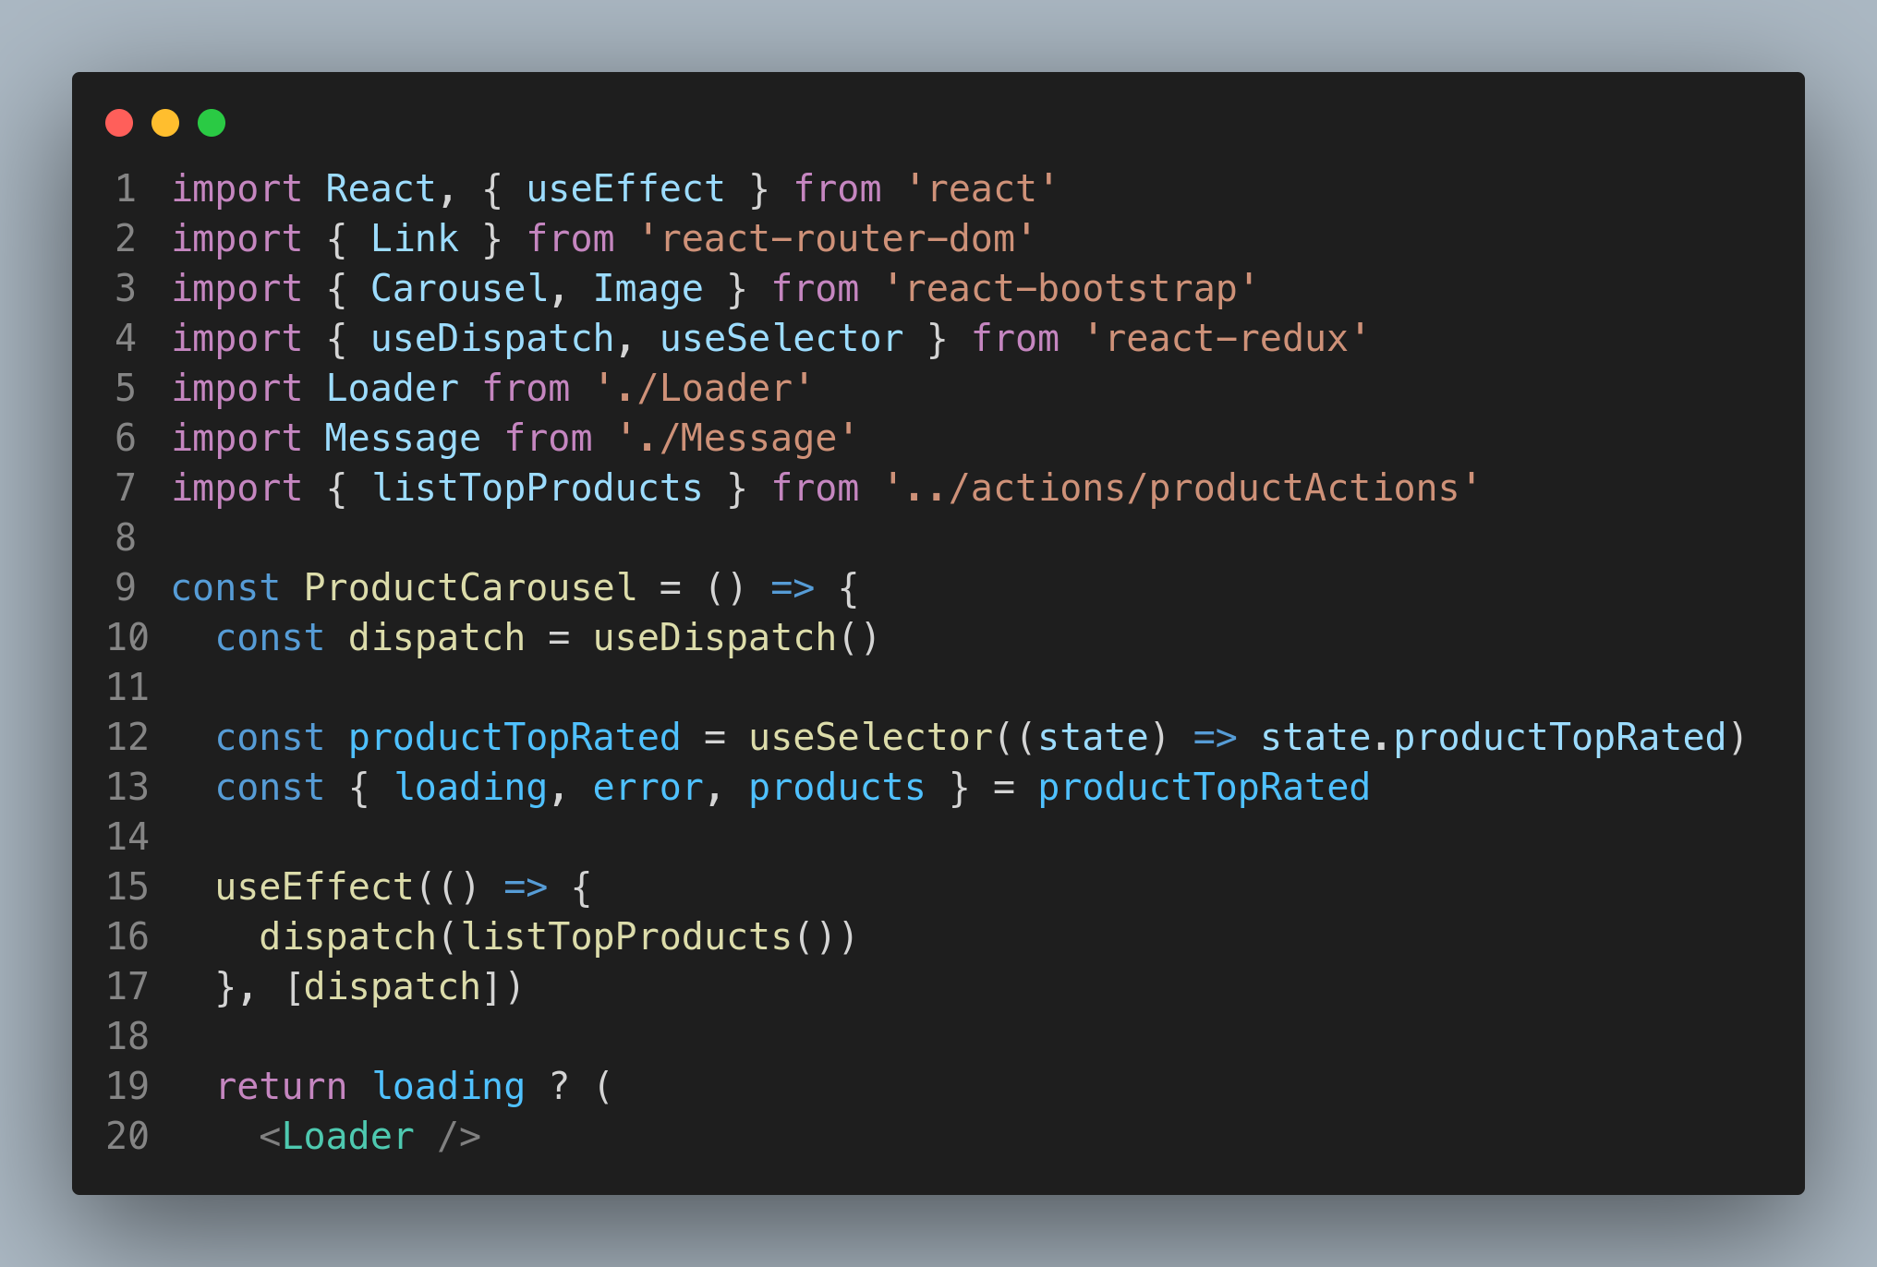
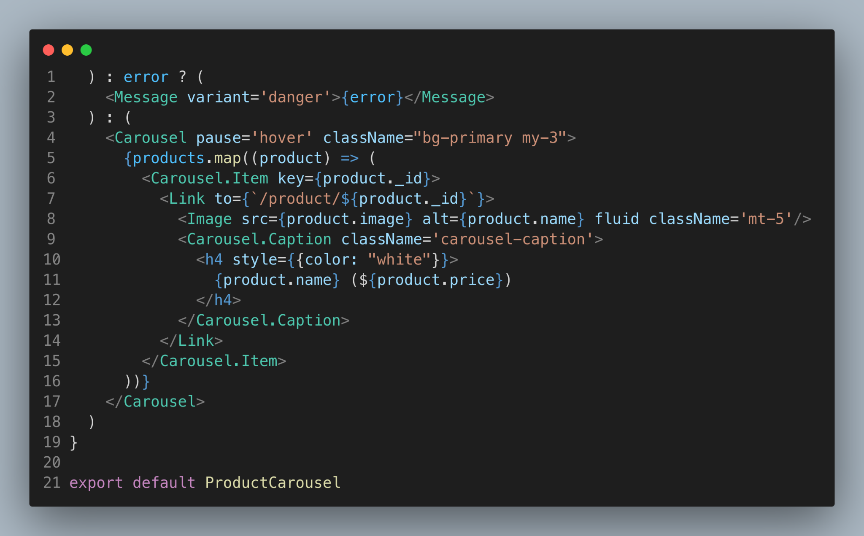

Slide 6
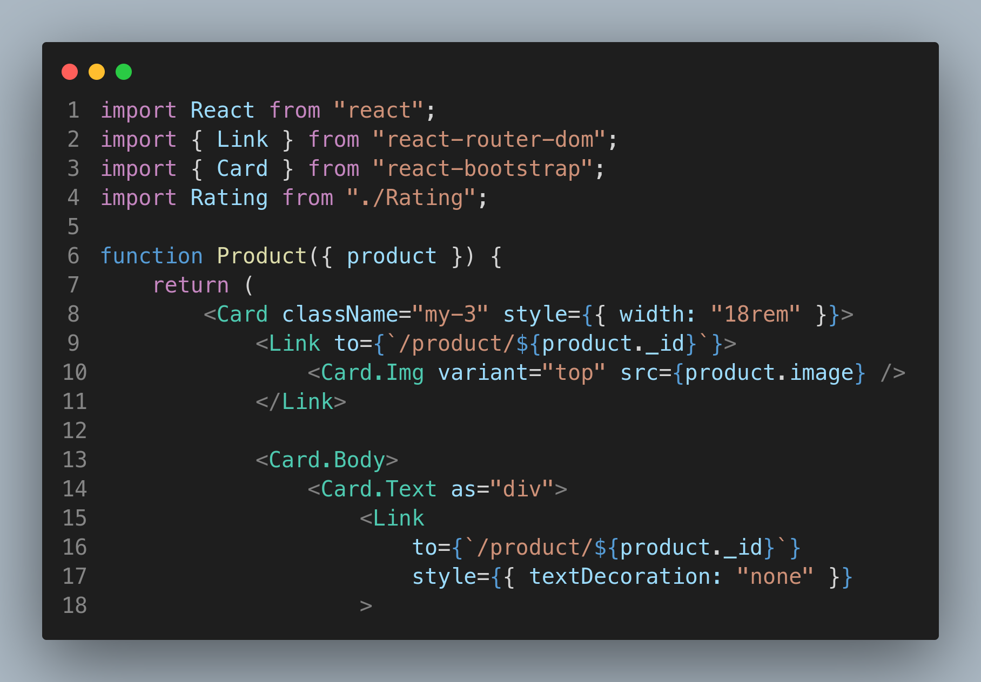
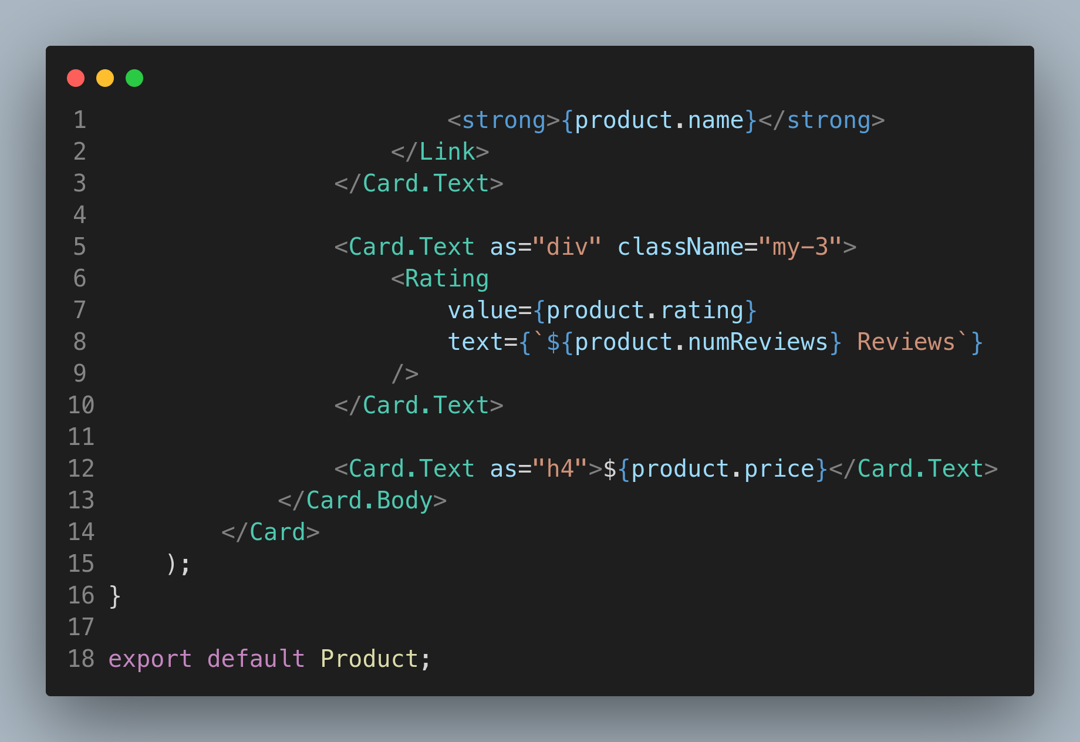

Slide 7
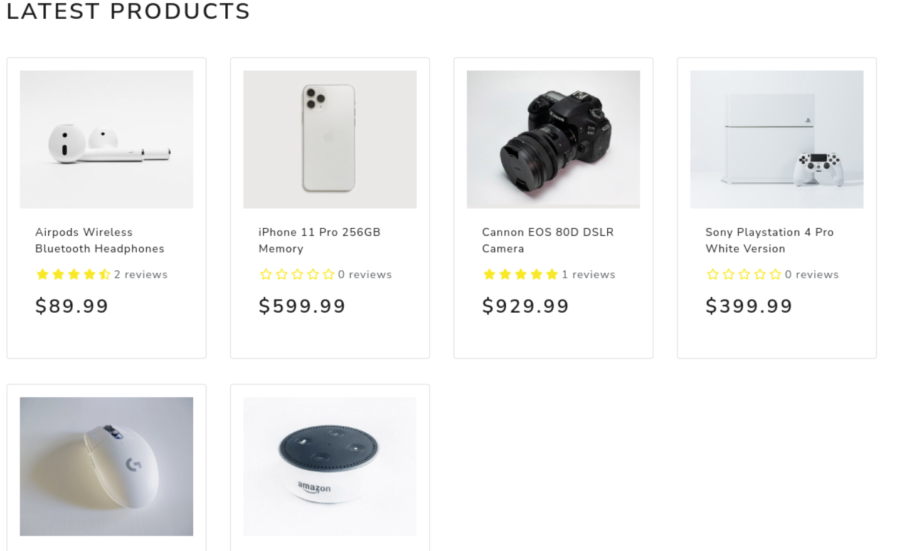
Latest Products
The "Latest Products" section of InstaShop's website showcases the newest and most popular products available on the site. This section is prominently displayed on the homepage, making it easy for customers to stay up-to-date with the latest trends and products.

Slide 8
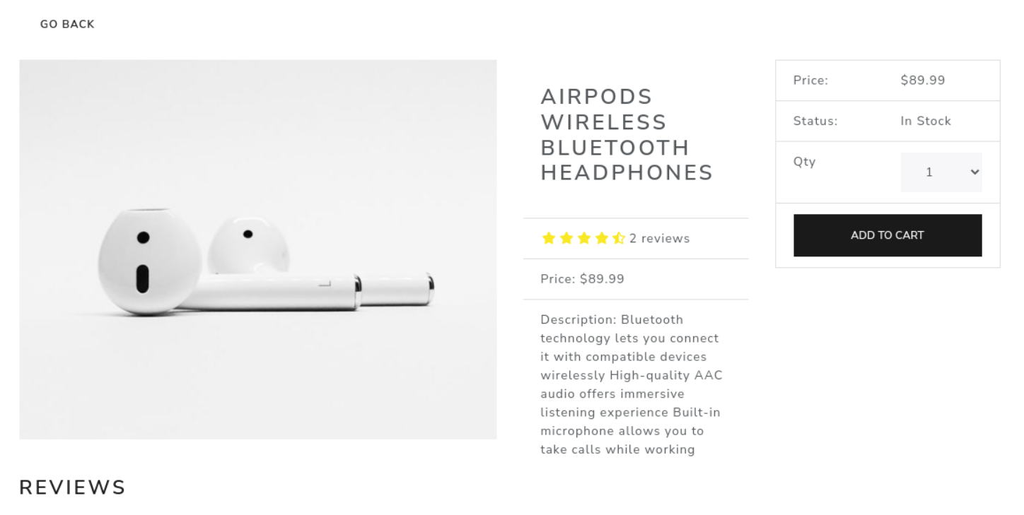
Product Page
The "Product Details" section of InstaShop's website provides customers with in-depth information about the products they are interested in. This section includes high-quality images of the product, a detailed product description, and a list of features and specifications, allowing customers to make informed purchasing decisions.The section also includes customer reviews and ratings, providing valuable insights and helping customers to make informed decisions about the products they're considering.

Slide 9
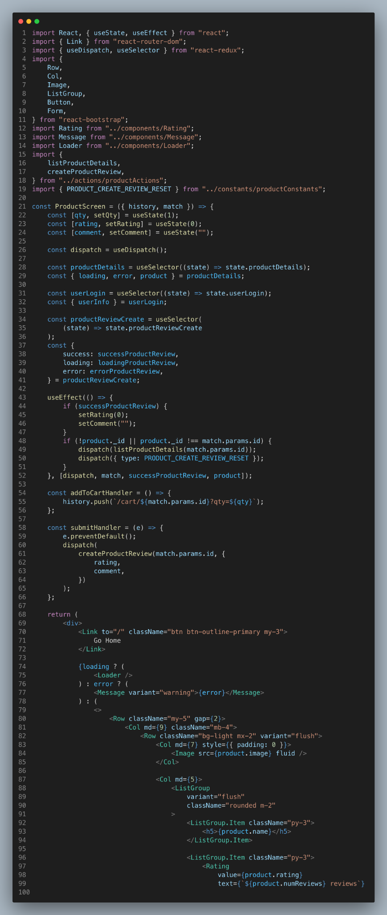
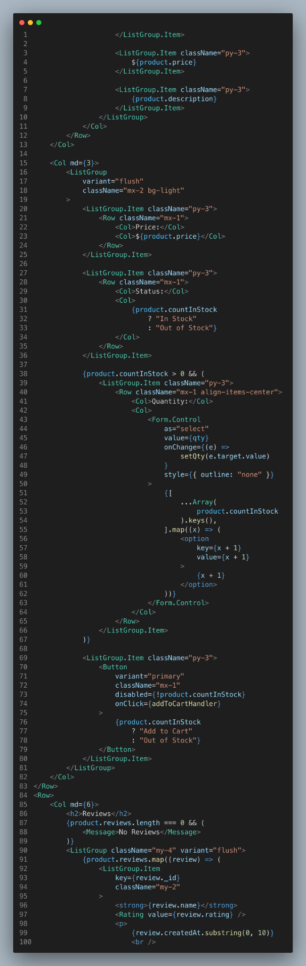
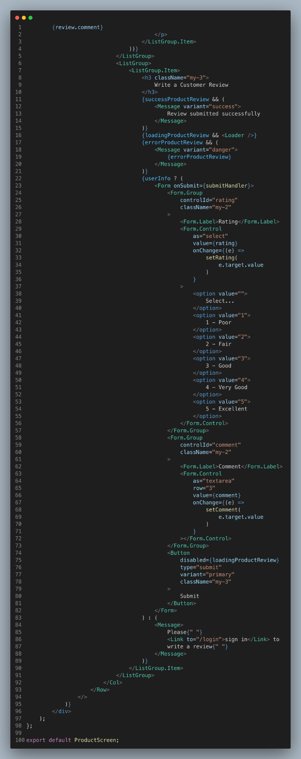

Slide 10
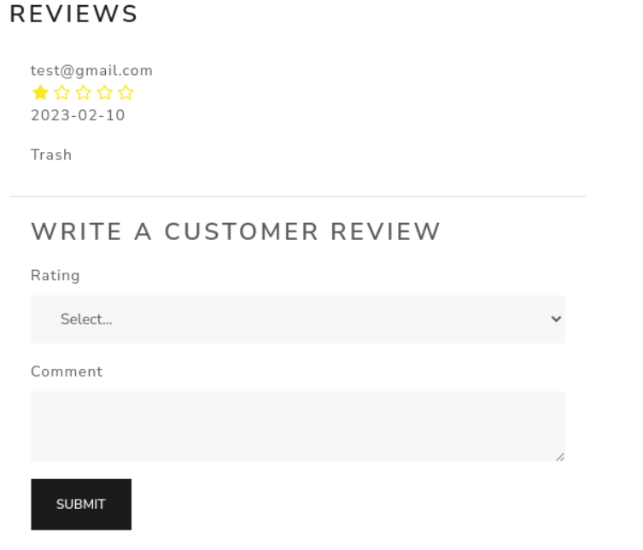
Product Review
The "Product Review" section of InstaShop's website allows customers to share their experiences and opinions about the products they have purchased. Customers can rate the product, write a review to help other customers make informed purchasing decisions. With its comprehensive and user-generated content, the Product Review section of InstaShop's website helps customers to make informed purchasing decisions and provides valuable insights into the products they are considering.

Slide 11
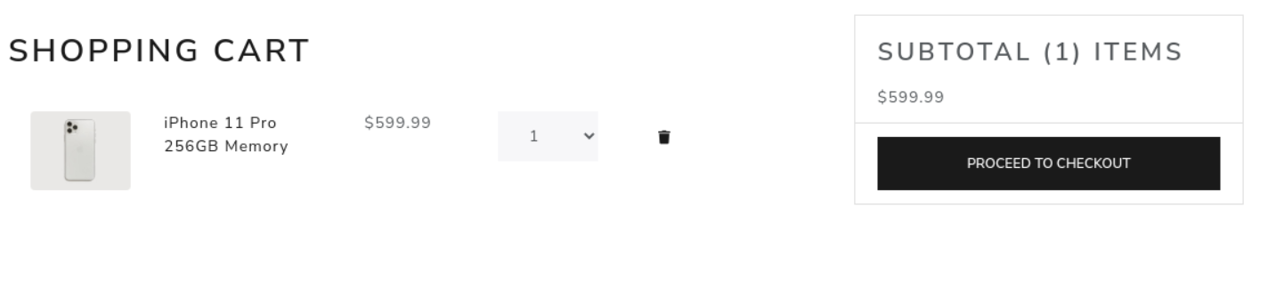
Shopping Cart
The "Shopping Cart" on InstaShop's website is a convenient and efficient way for customers to manage their purchases. The cart allows customers to add, remove, and view items as they shop, providing a real-time update on the items and costs in their cart. The shopping cart also displays the subtotal, shipping fees, and tax, giving customers a clear understanding of their total costs. With its easy-to-use interface and real-time updates, the Shopping Cart on InstaShop's website helps customers to manage their purchases with confidence and ensures a smooth and seamless checkout experience.

Slide 12
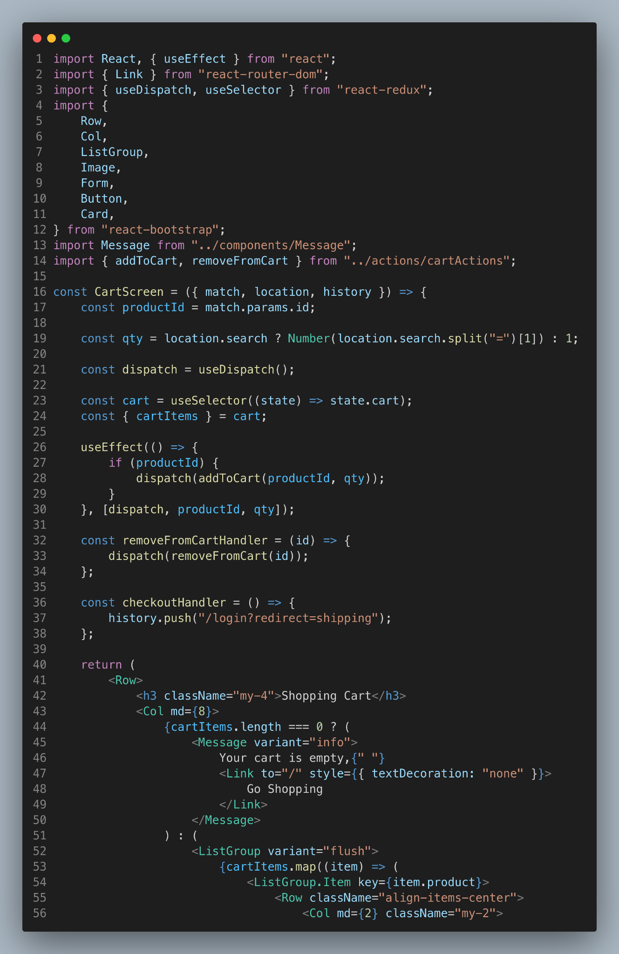
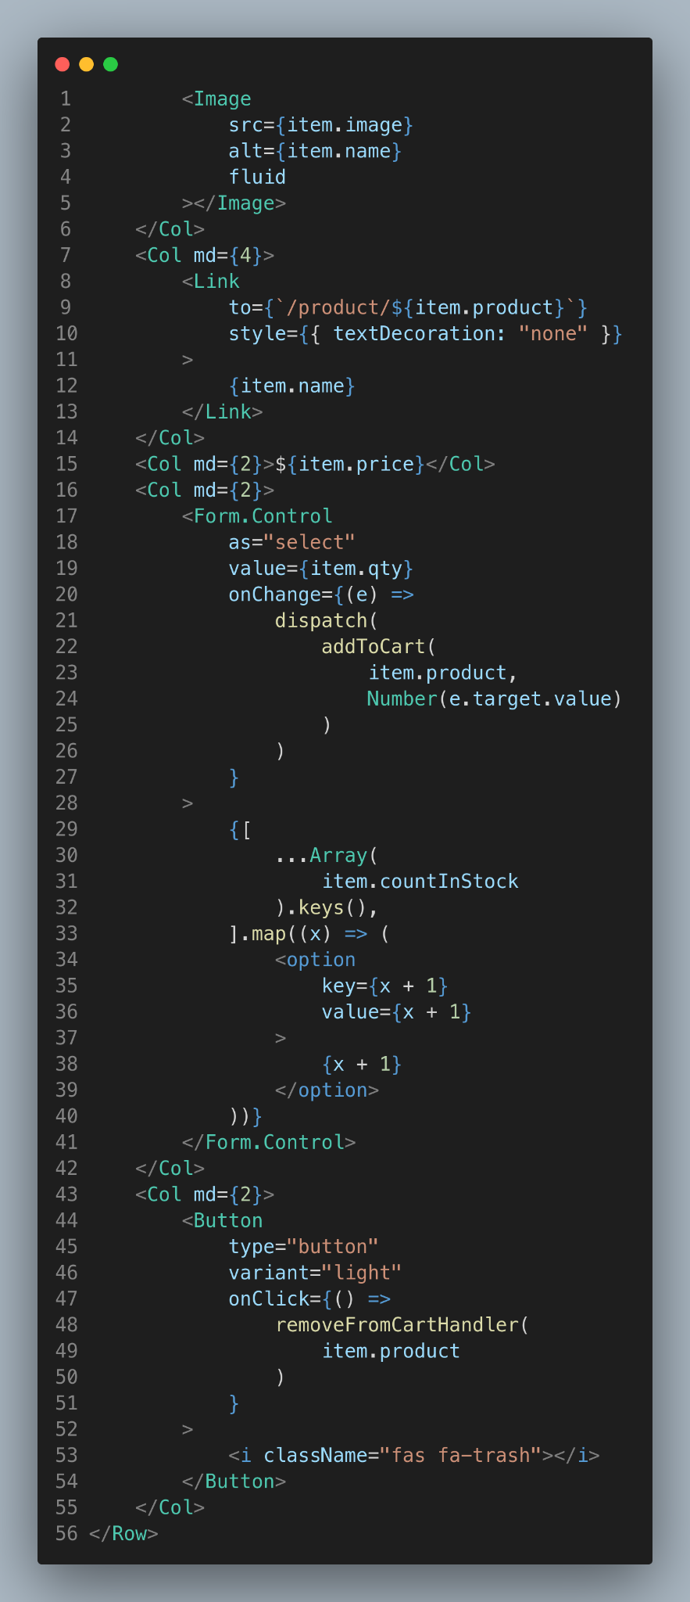
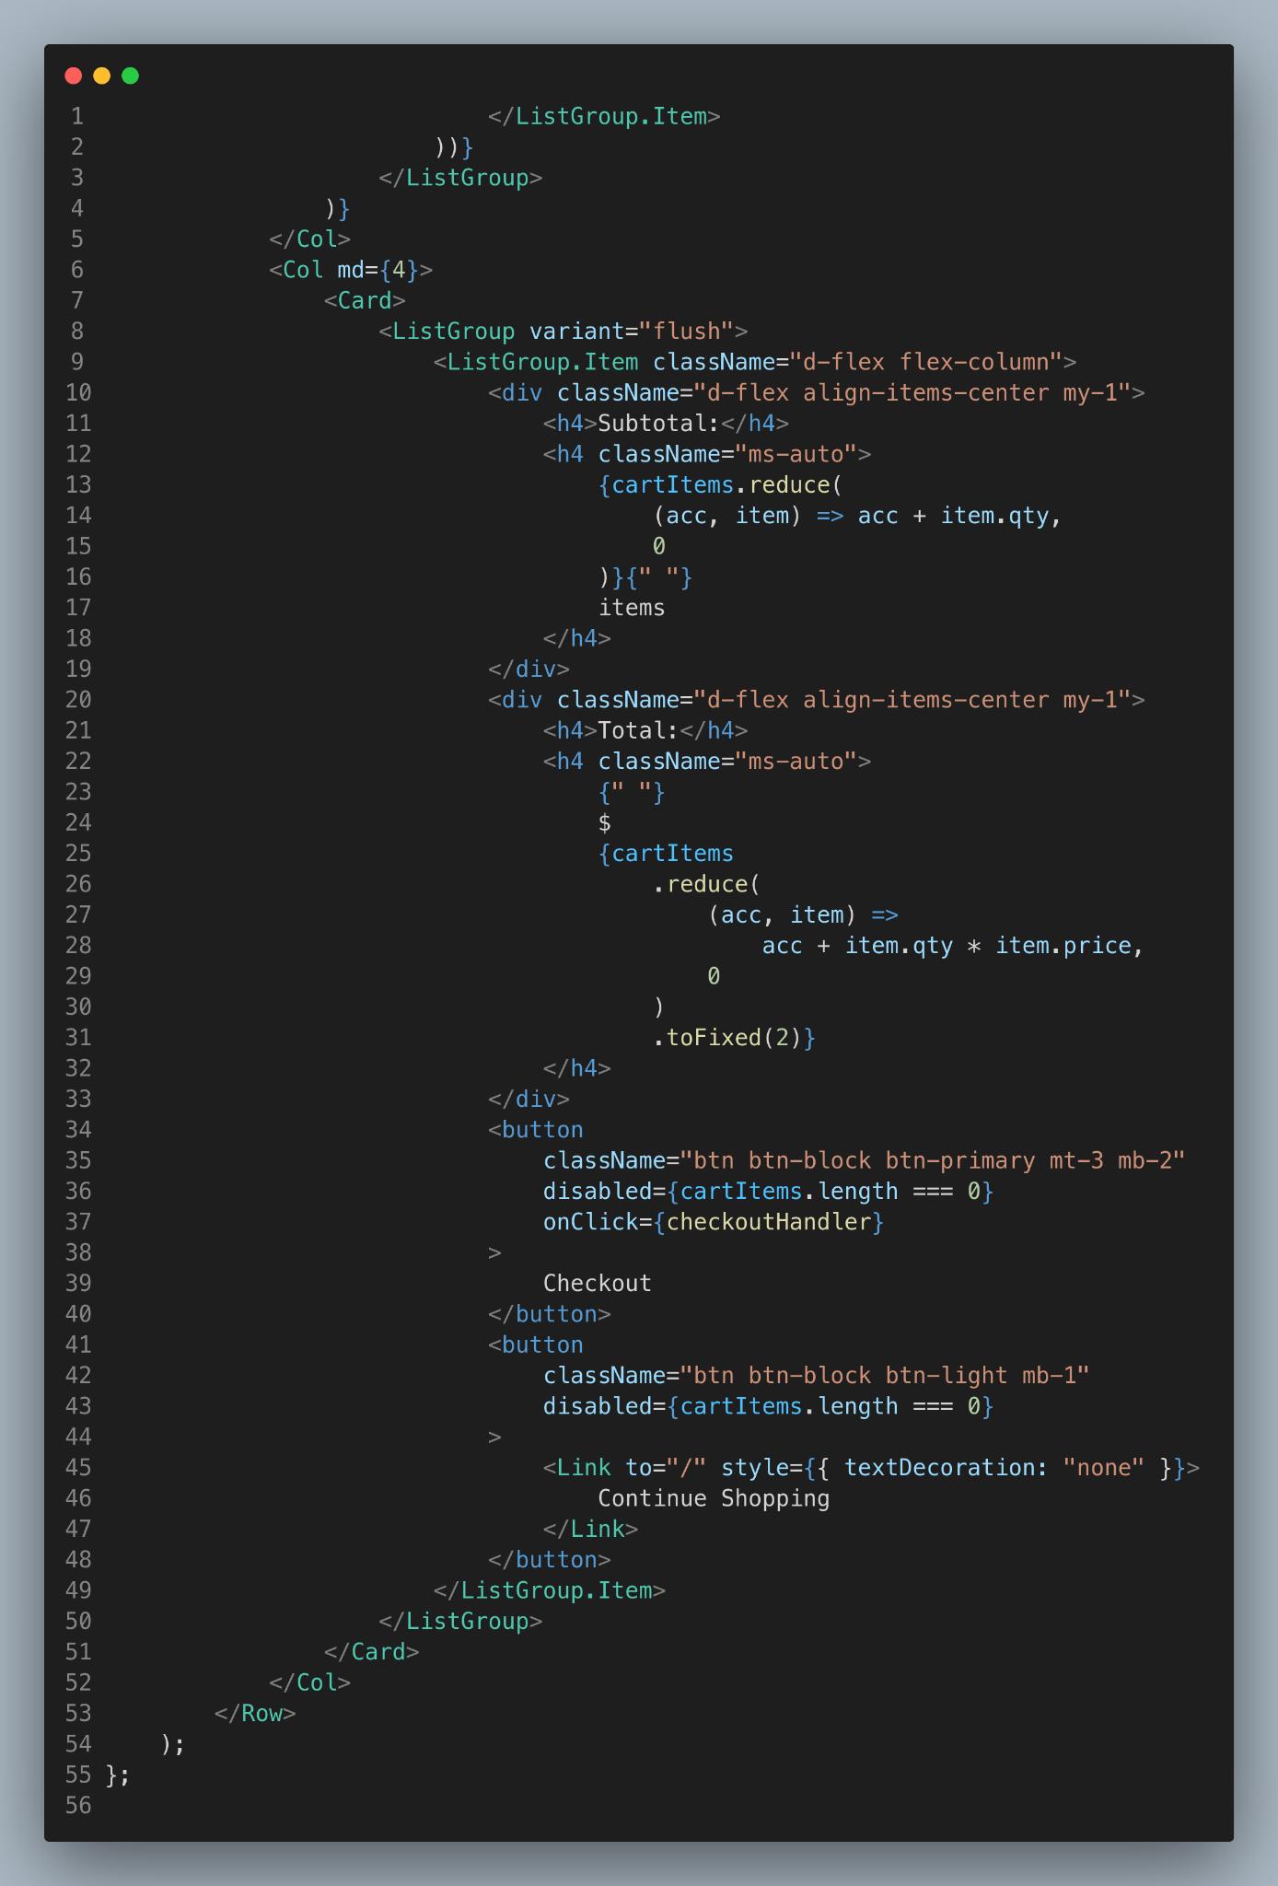

Slide 13
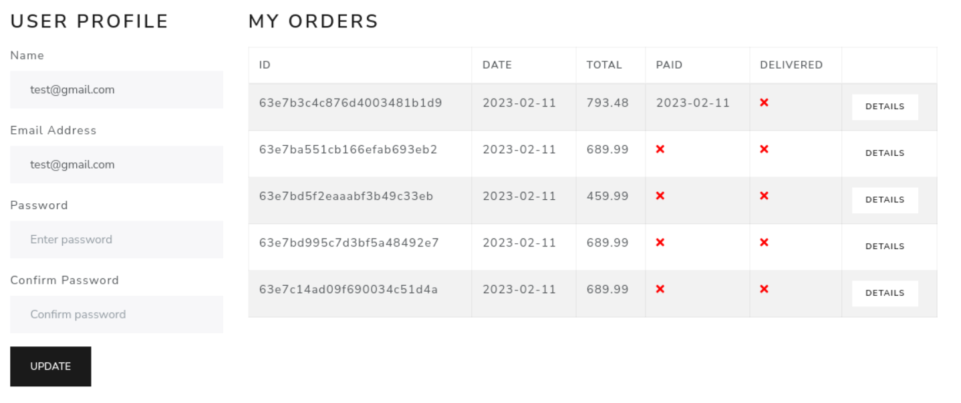
User Profile
The user profile in InstShop's ecommerce website allows users to manage their personal information and view their order history. Users can update their profiles, including shipping and billing information, with just a few clicks. The order details section provides a comprehensive overview of all previous orders, including order numbers, dates, and purchase amounts, making it easy for users to keep track of their shopping history.

Slide 14
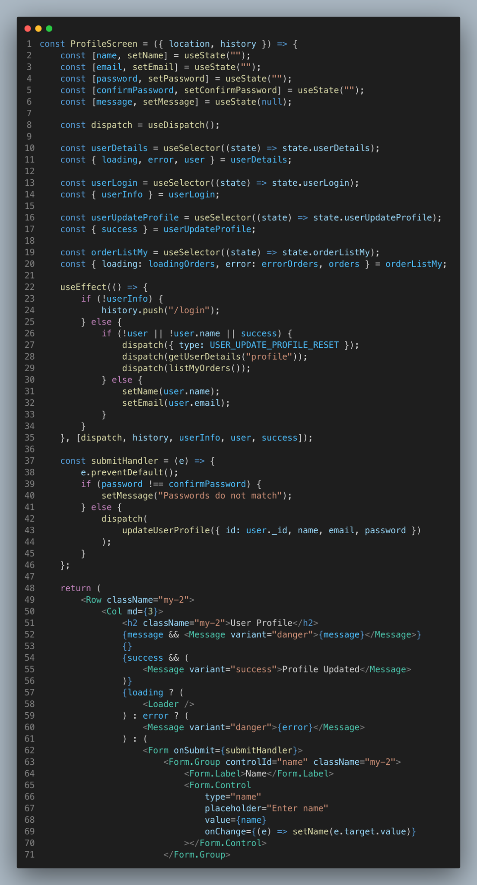
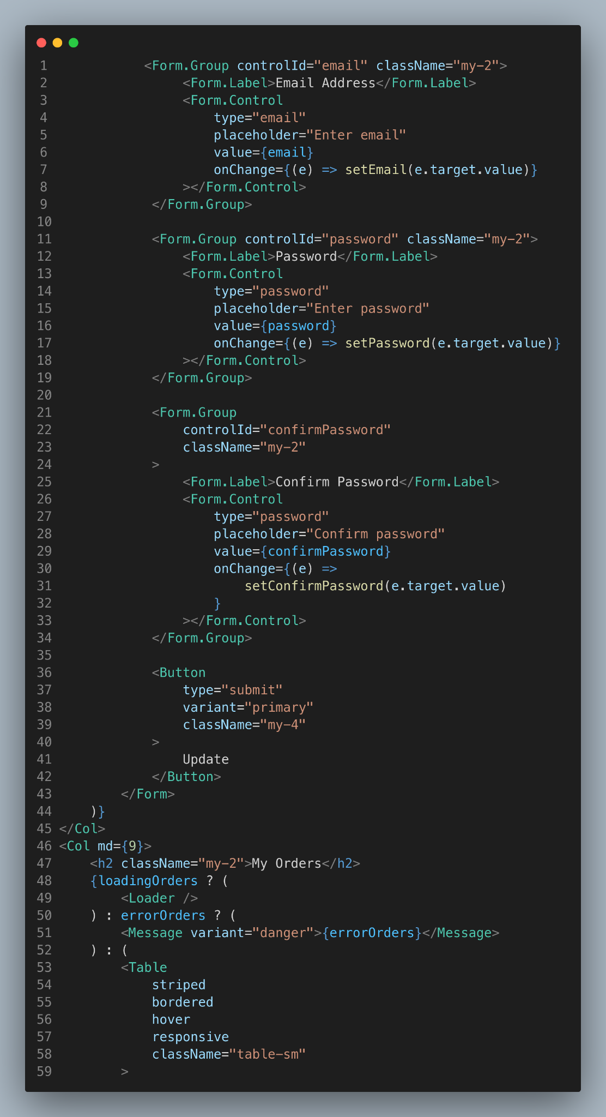
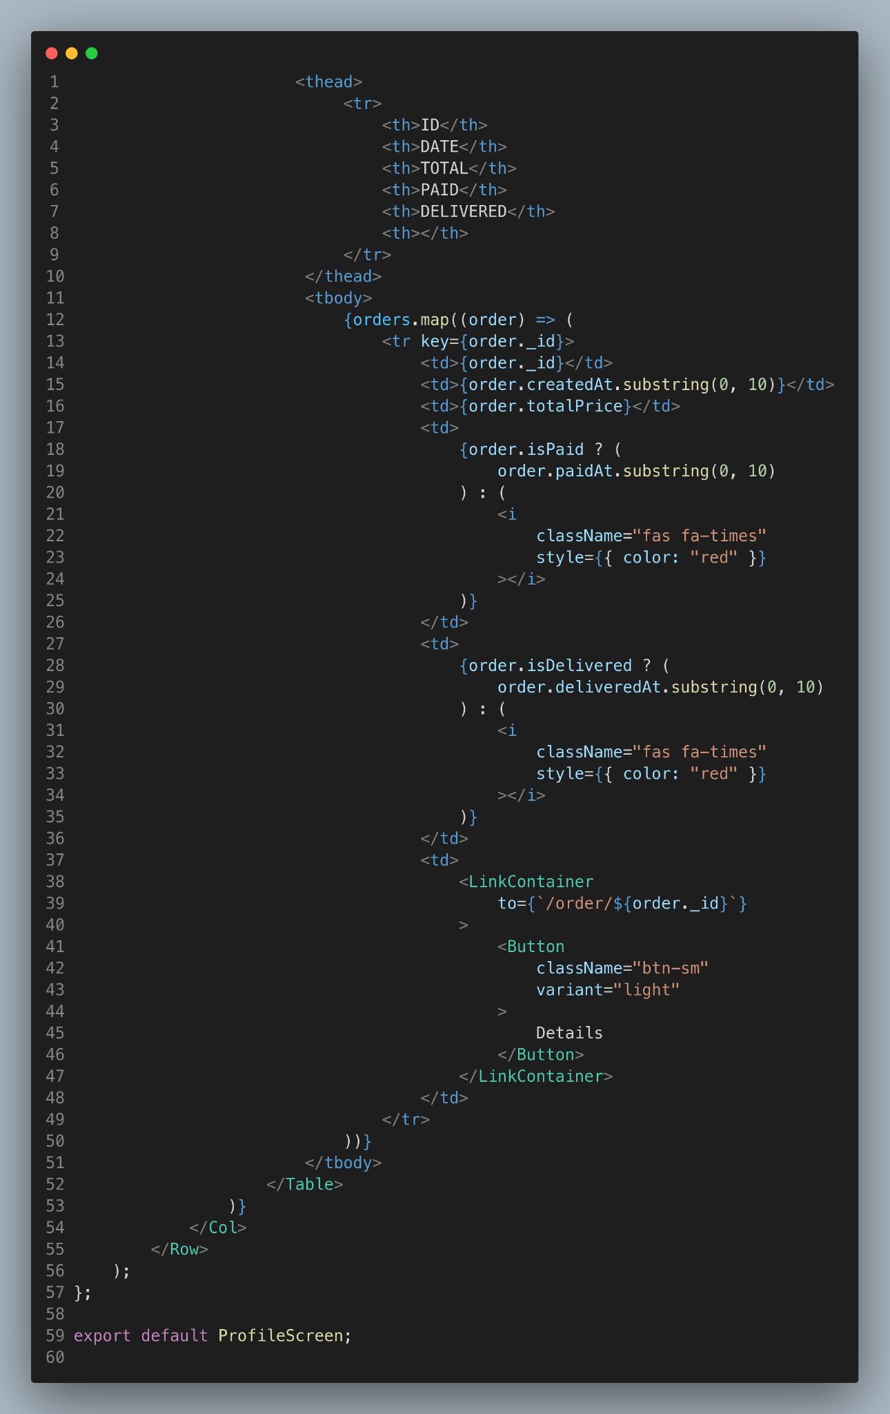

Slide 15
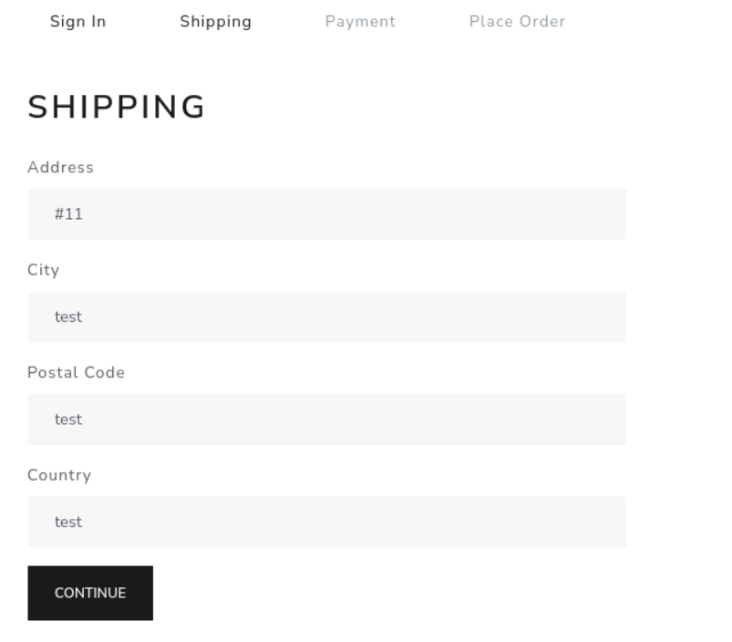
Shipping
The shipping page in InstaShop's ecommerce website allows customers to enter their shipping details, including their full name, shipping address, and contact information. This information is used to calculate shipping costs and ensure that orders are delivered to the correct address, making the checkout process smooth and efficient.

Slide 16
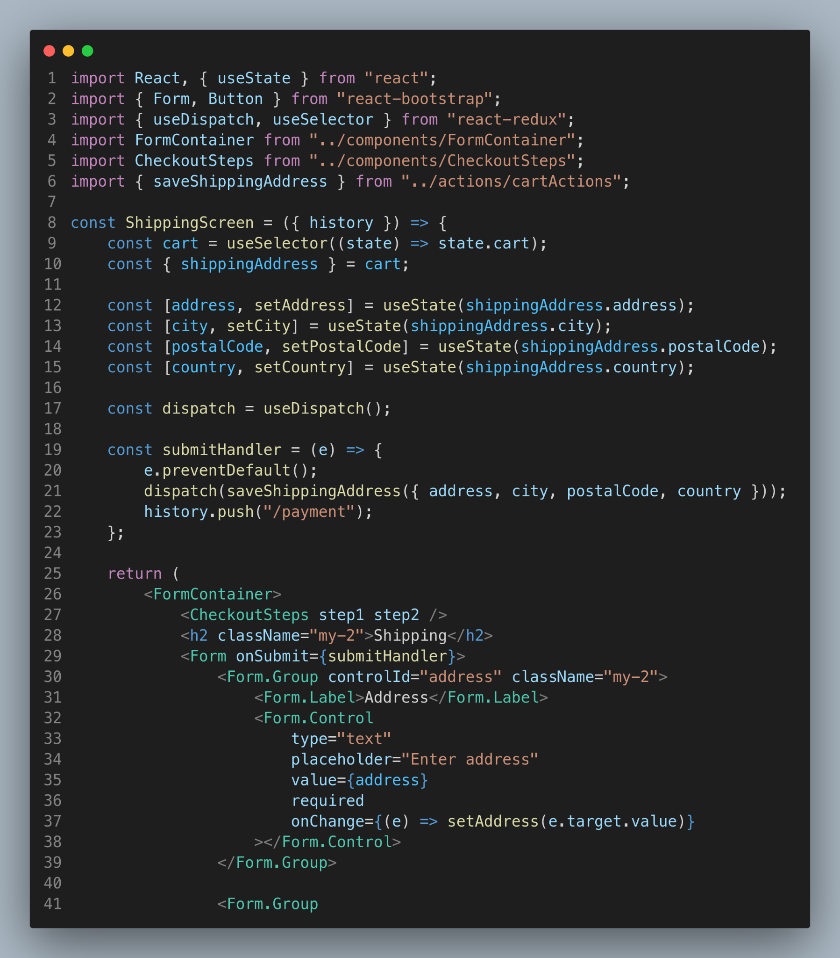
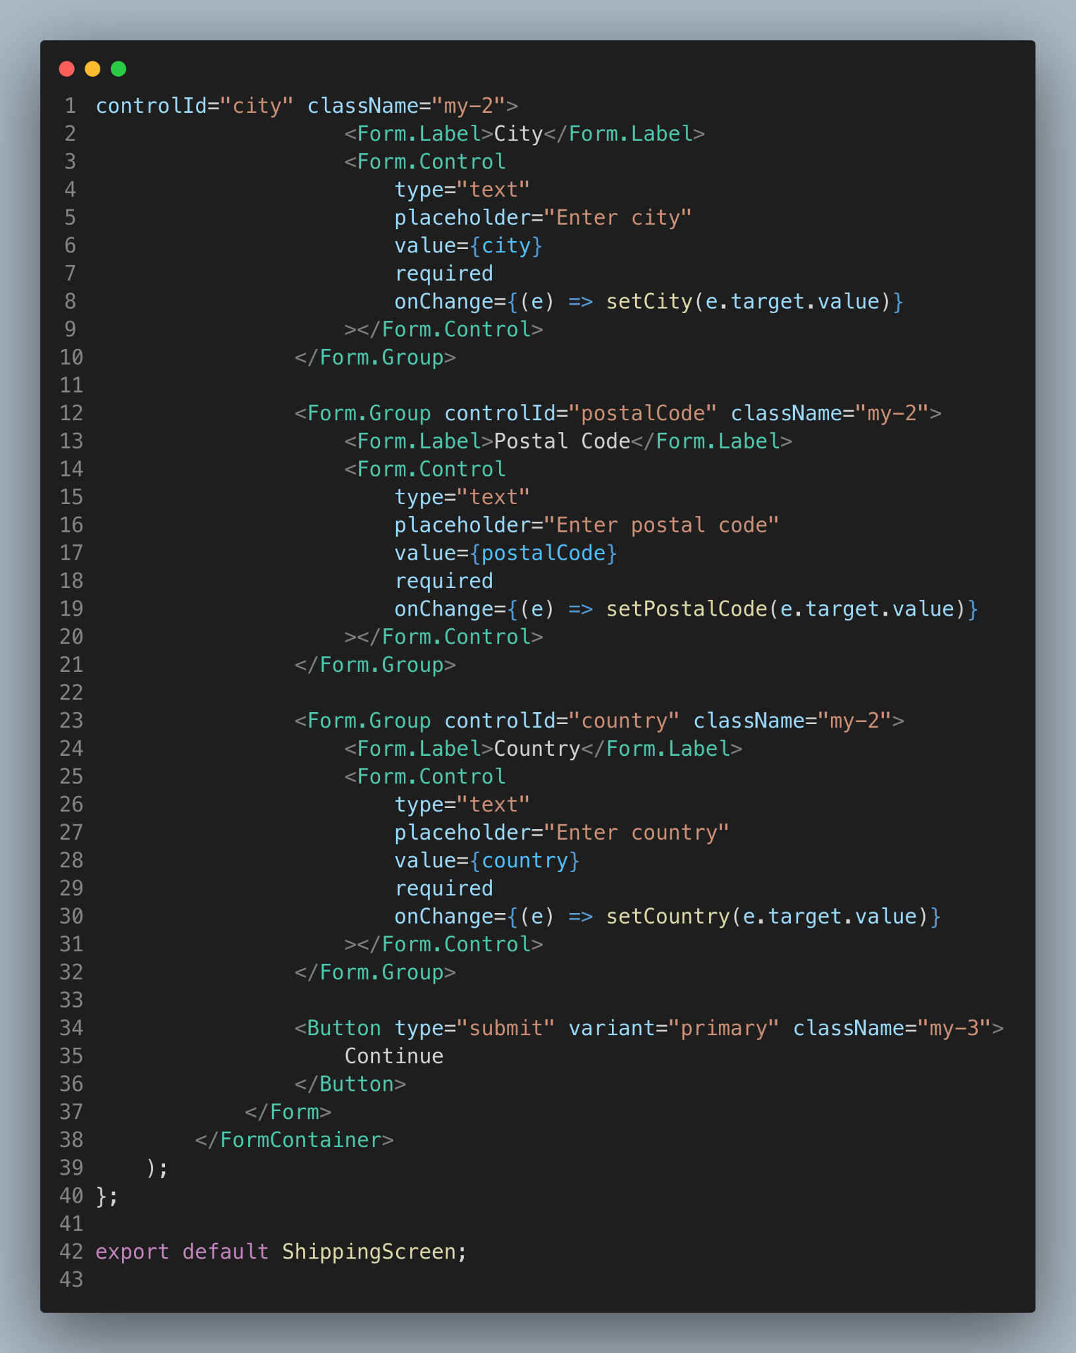

Slide 17

Payment
The payment process in InstaShop’s ecommerce website allows customers to choose from a variety of payment methods, including Paypal and credit card. This feature provides a secure and convenient way for customers to complete their purchases, ensuring that their personal and financial information is protected.

Slide 18
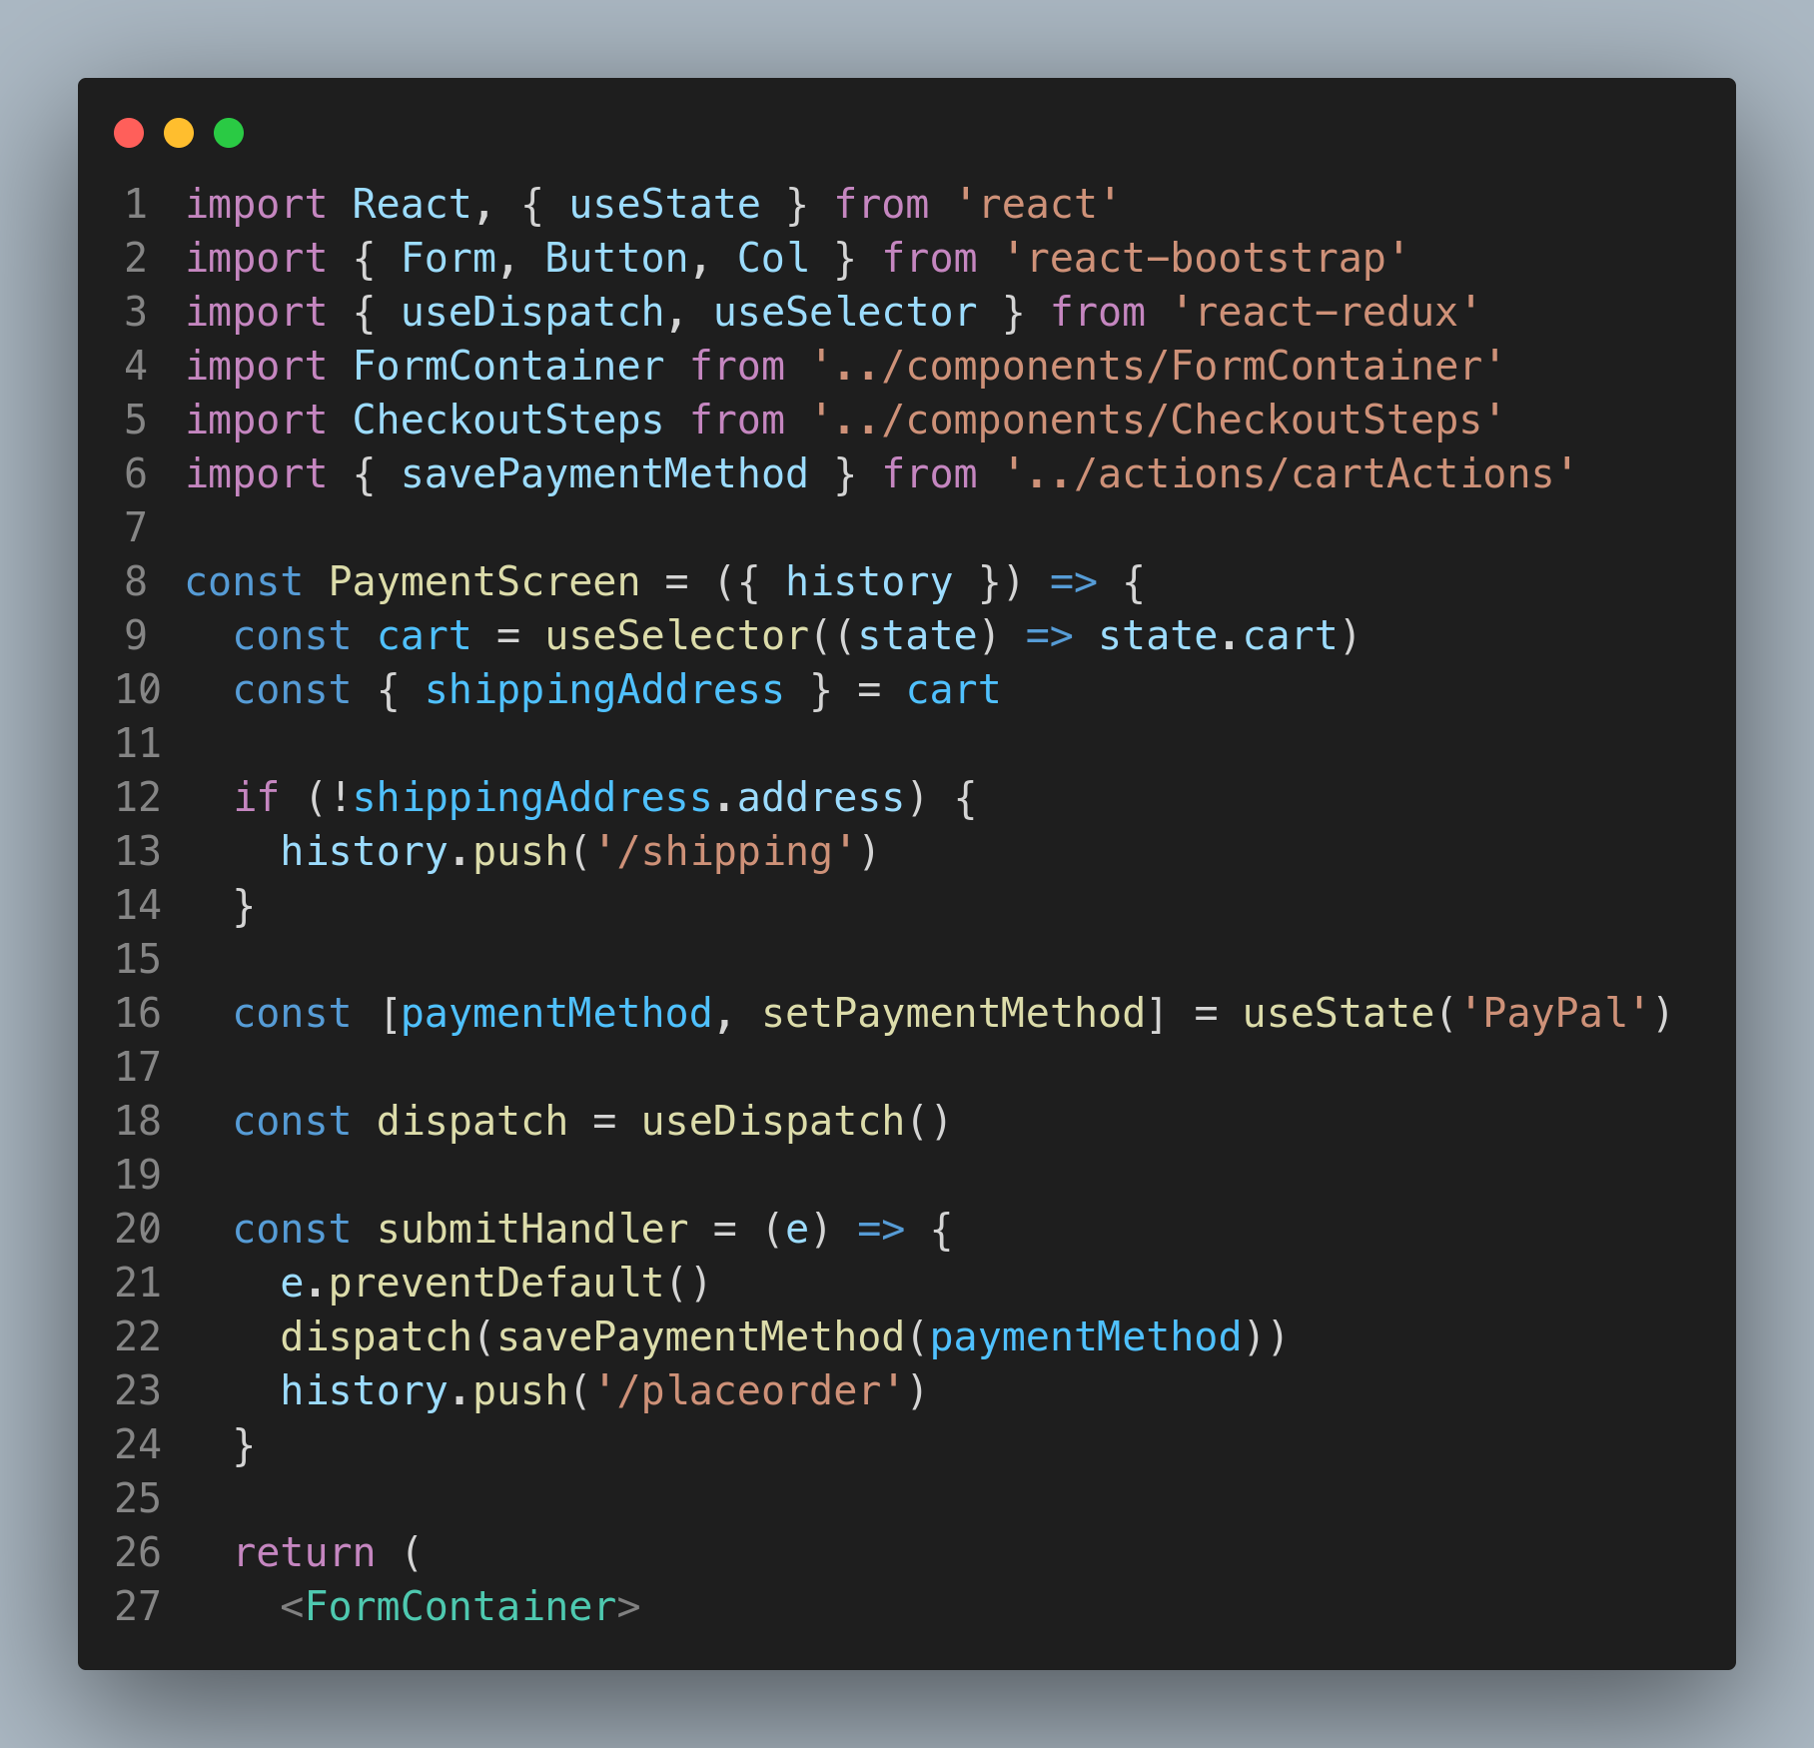
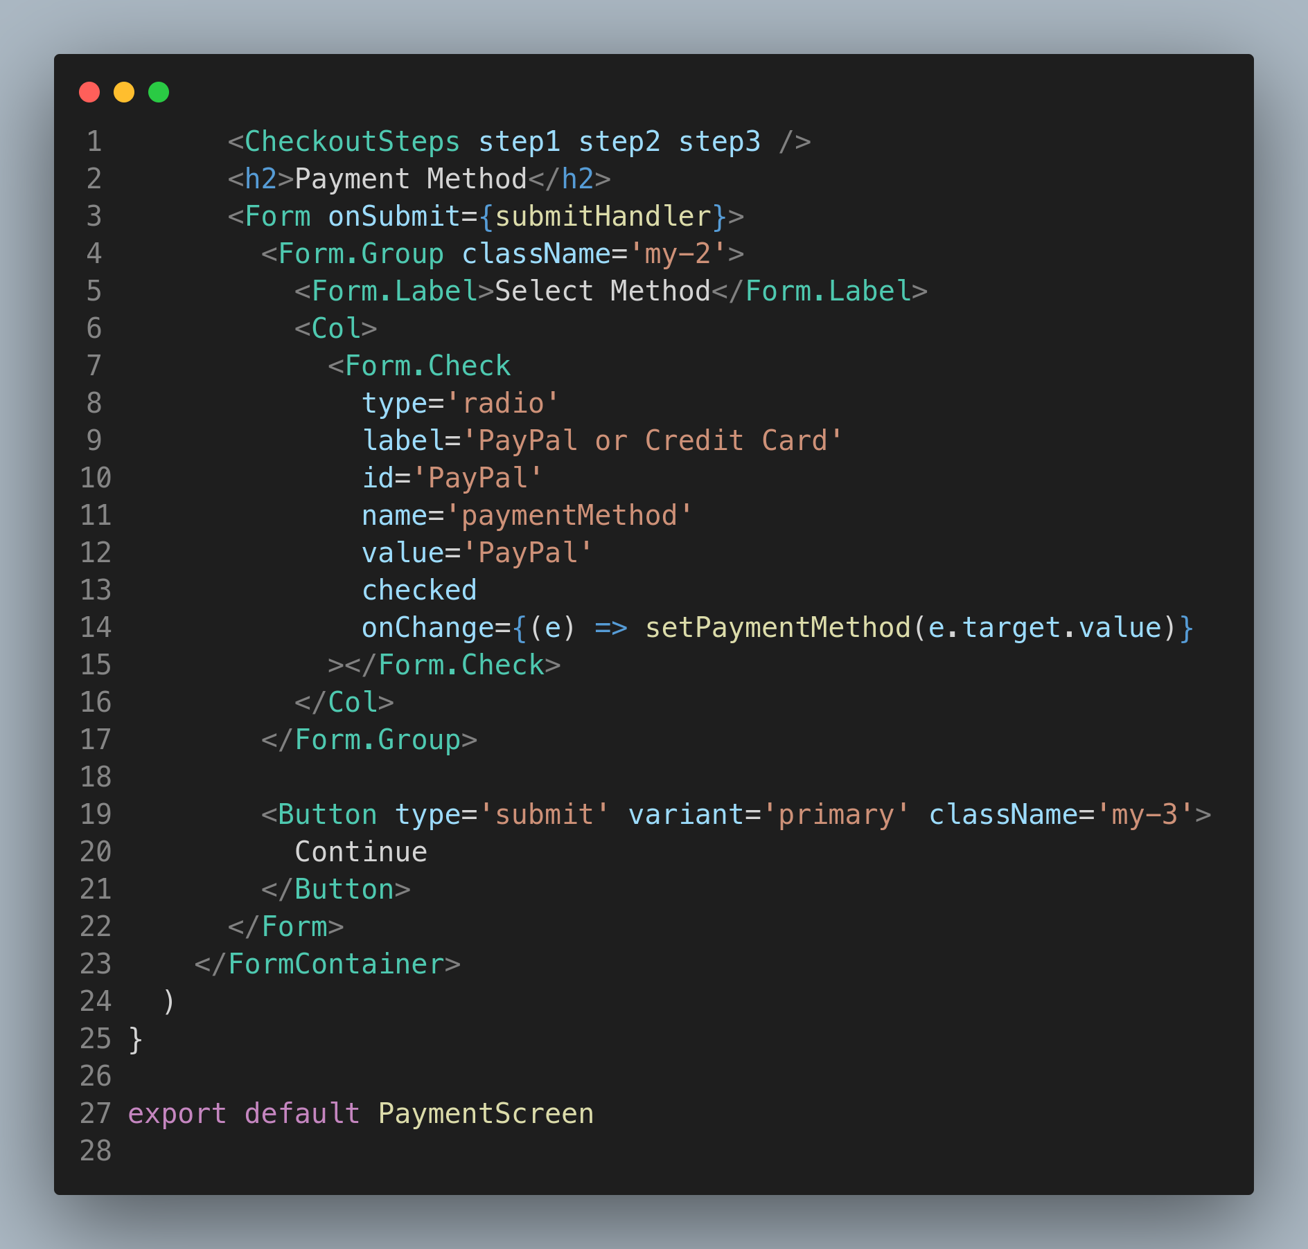

Slide 19
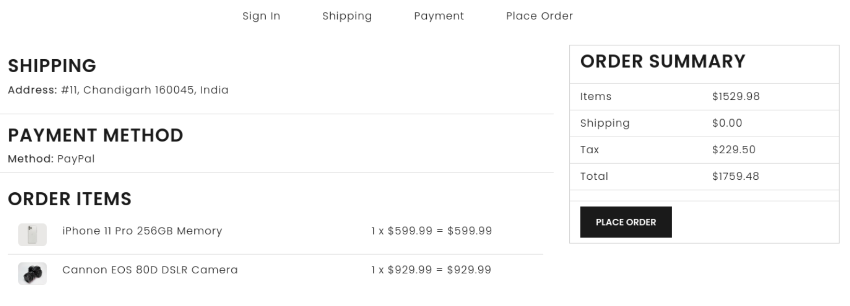
Order Place
The "Order Place" page of InstaShop's website is where customers finalize and complete their purchases. The page is designed to be secure and user-friendly, allowing customers to easily enter their shipping and payment information. The page displays a summary of the items in the customer's cart, the total cost of the order, and the estimated delivery date. Customers can choose from a range of shipping options and payment methods, including credit card, PayPal, and more. With its clear and straightforward design,

Slide 20
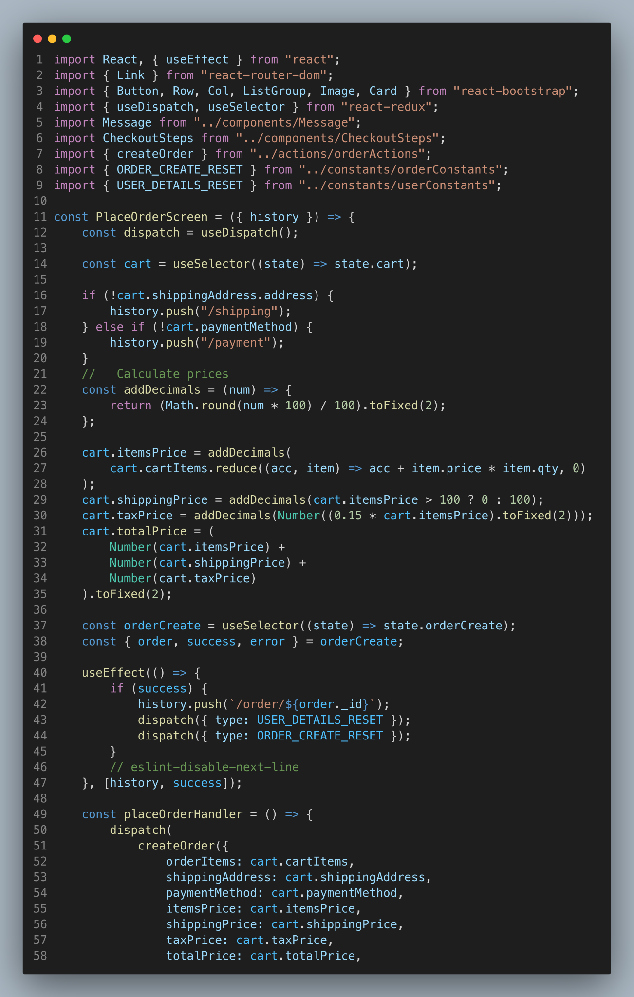
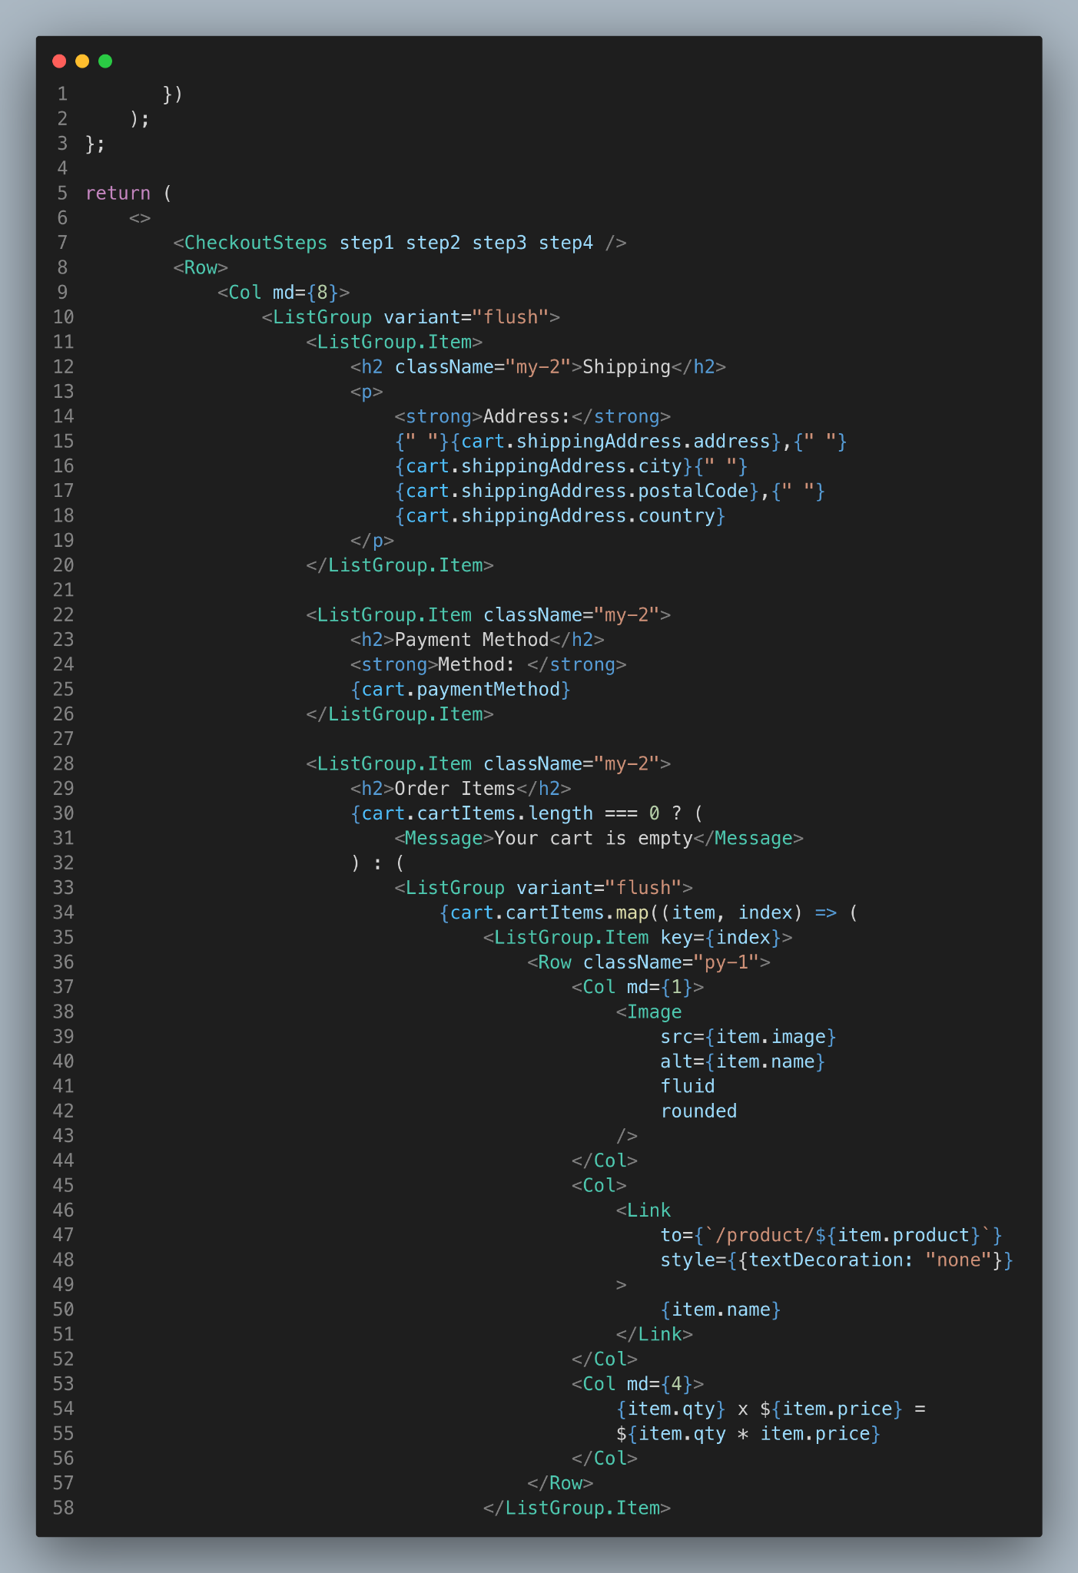
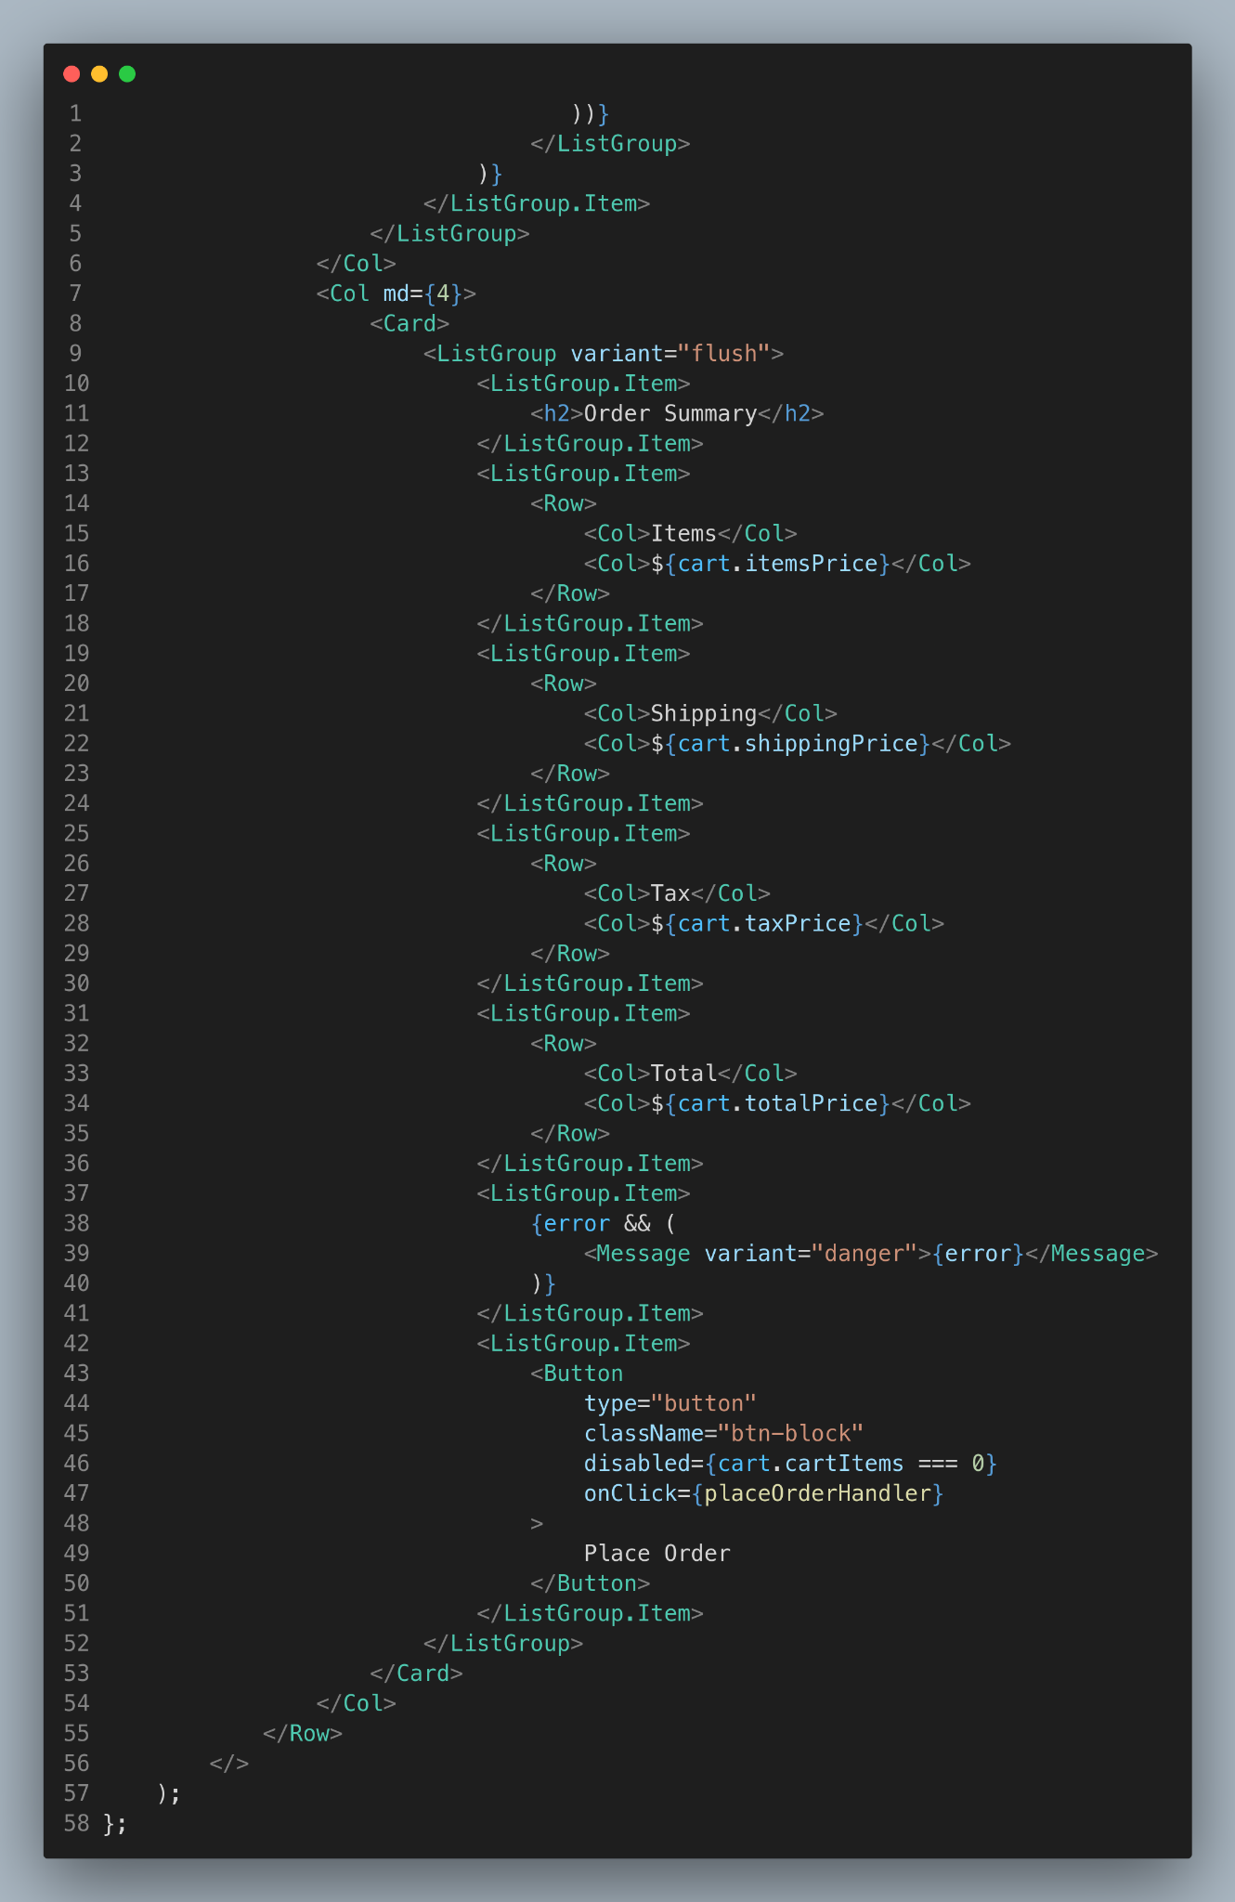

Slide 21
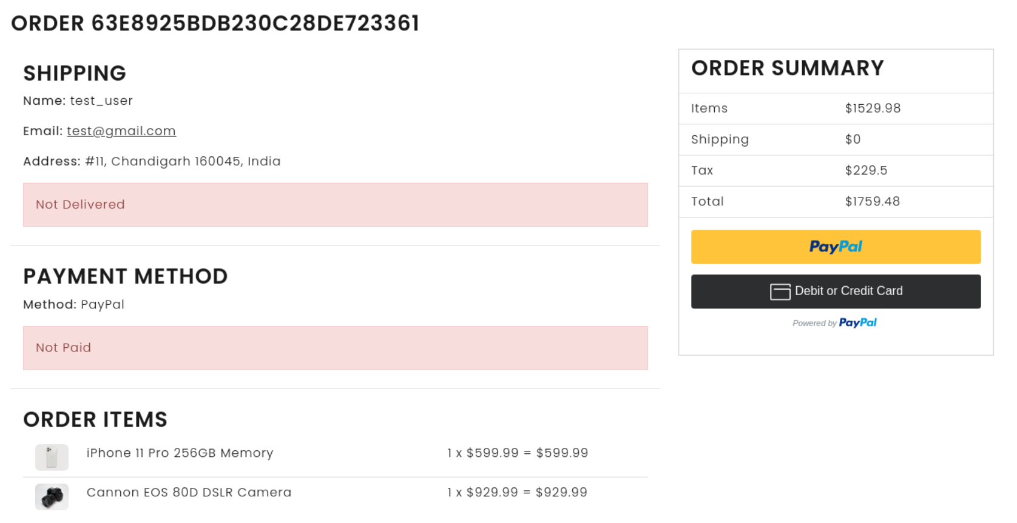
Order Page
The "Order" page in InstaShop's ecommerce website provides a comprehensive overview of all order details, including shipping information, ordered items, and payment method. This page also features an additional Paypal button, which uses Paypal's REST API for secure and efficient payment processing. Once the payment is made, the status of the payment is immediately updated, ensuring that customers always have up-to-date information about their orders

Slide 22
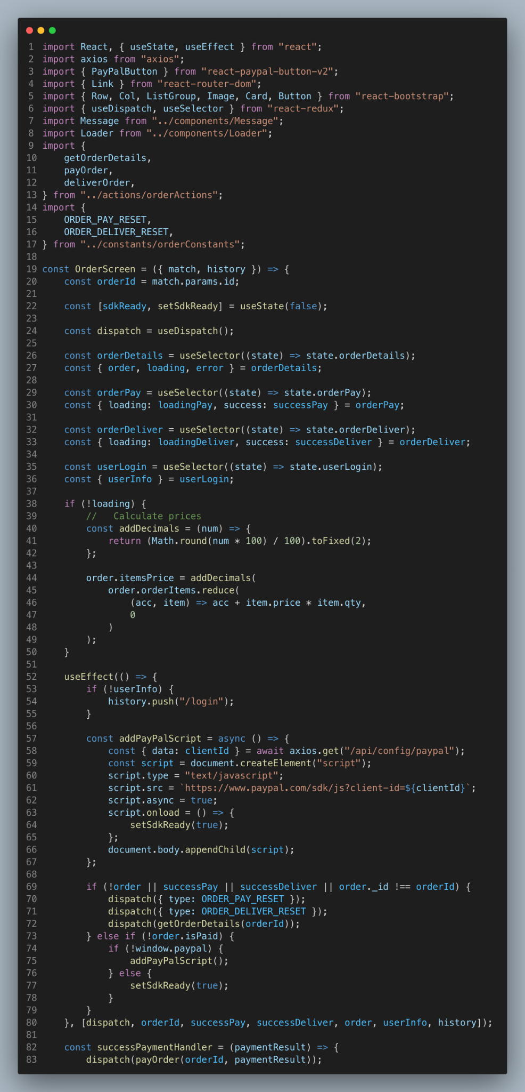
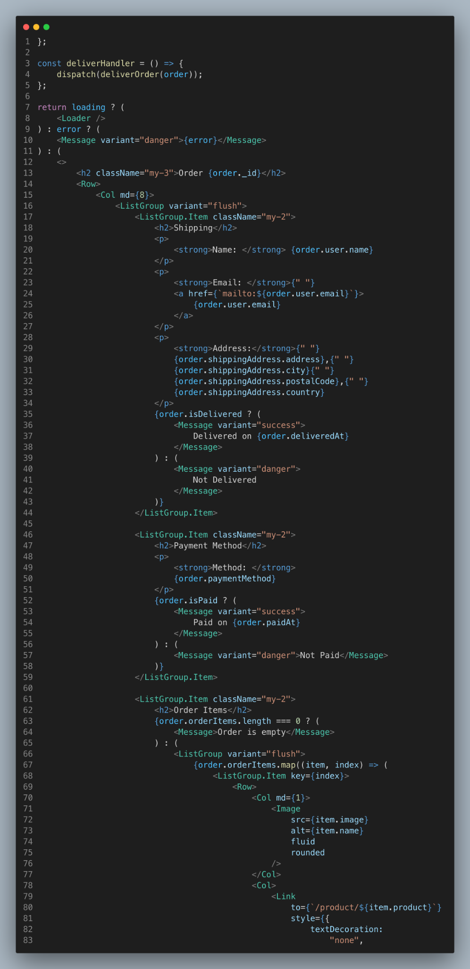
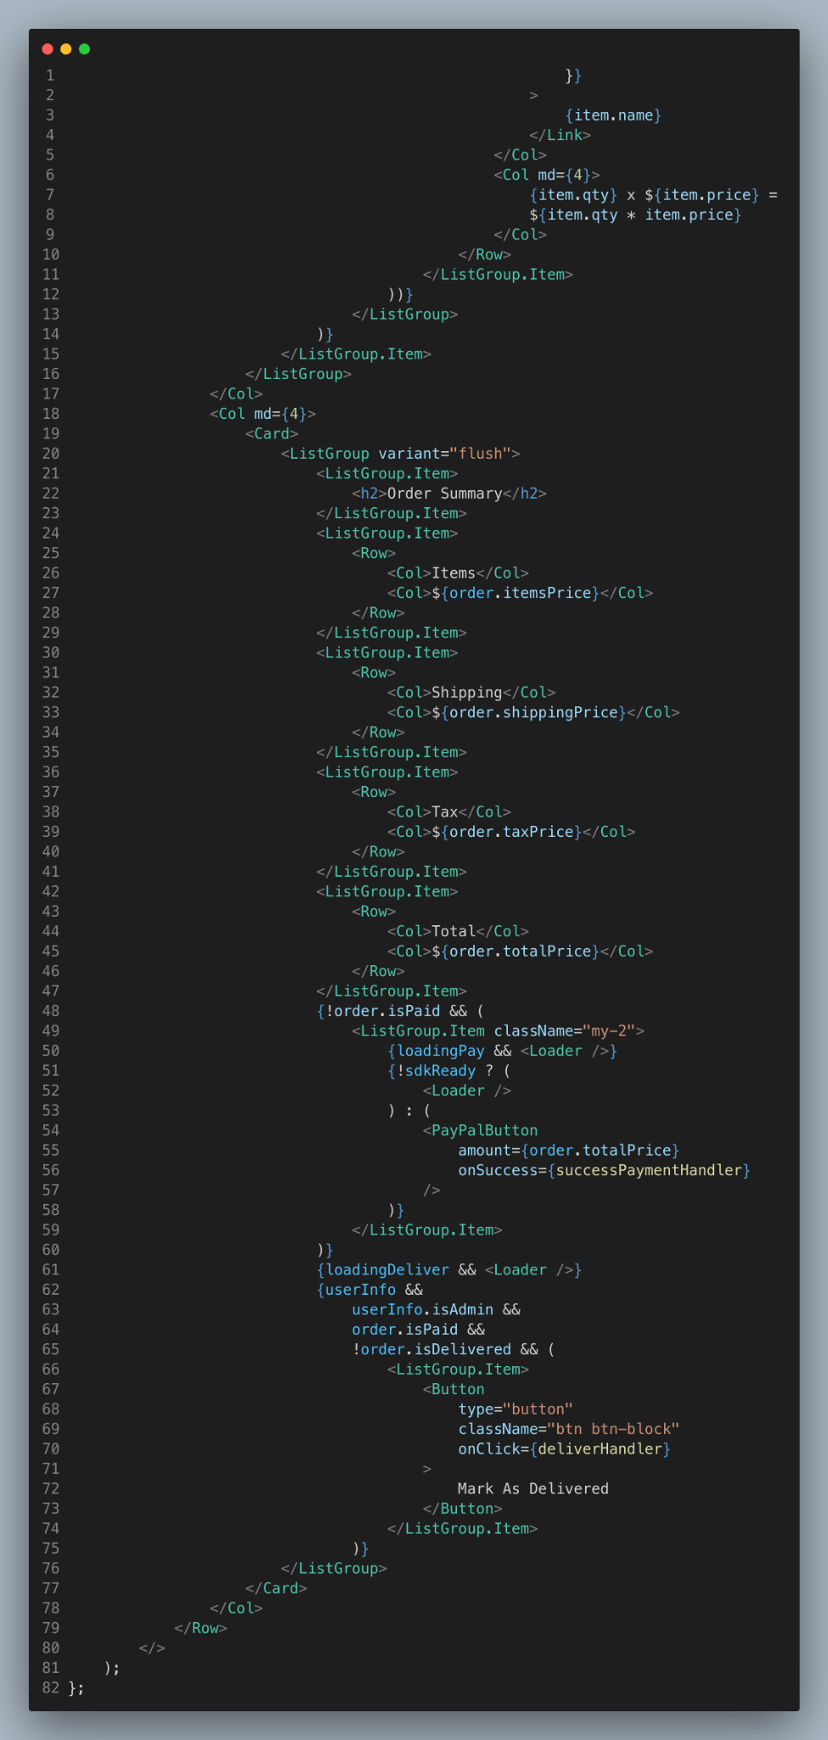

Slide 23
Thank You!
Thank you for taking the time to review the different components of InstaShop's website. I hope the information provided has given you a good understanding of what the site has to offer. If you have any further questions or would like to learn more, please don't hesitate to reach out. Thank you again for your interest in InstaShop!

Slide 24
Name – Muskan Roll No – 2010993752

